Slide 1
Introduction to General Purpose computing on the Graphics Processing Unit (GPGPU)
Sam Loescher
Notes:
- Greeting - Brief introduction to the GPU and how you can use it
GPGPU advancing at speed
Exciting way forward for parallel computing
GPGPU associated with the big data domain
Gaining popularity high data throughput
I believe parallel computing to be the next progression in computing
GPU massively parallel

Slide 2
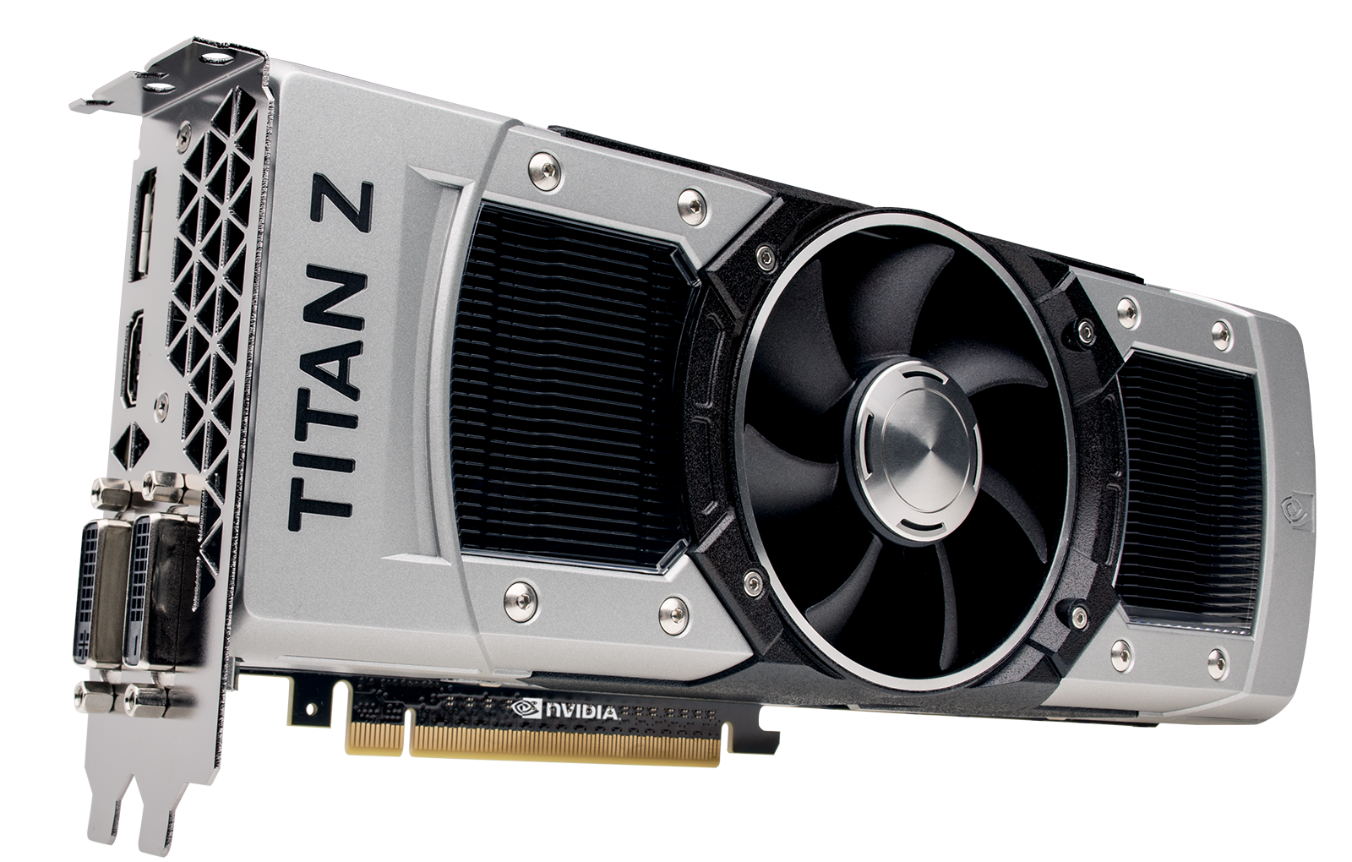
The Graphics processing unit (GPU)
Arguably cooler than the CPU
Notes:
Titan Z GPU
5760 CUDA cores

Slide 3
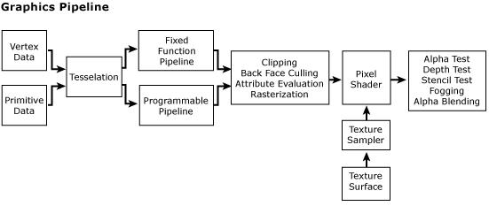
Brief history GPU
From the 2d to the 3d, from the CPU to the GPU
The fixed & programmable function pipeline
They have advanced as rapidly as the CPU
Notes:
First on CPU
GPU after for speed
Soon were incorporated into PCs due to their benefits processing graphics
GPU became standard in PC
Fixed Function pipeline
Not flexible
Programmable Function pipeline
Introduced freedom to program Vertex and Fragment shaders
Latest versions of openGL and DirectX
program the geometry shader
GPGPU before programmable graphics pipeline
encode the problems for the GPU
decode the data afterwards
easier now with CUDA and OpenCL
specifically made for programming the GPU for general purpose

Slide 4
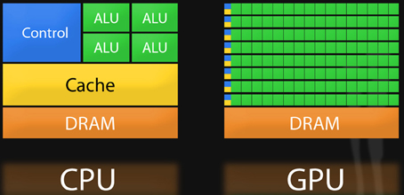
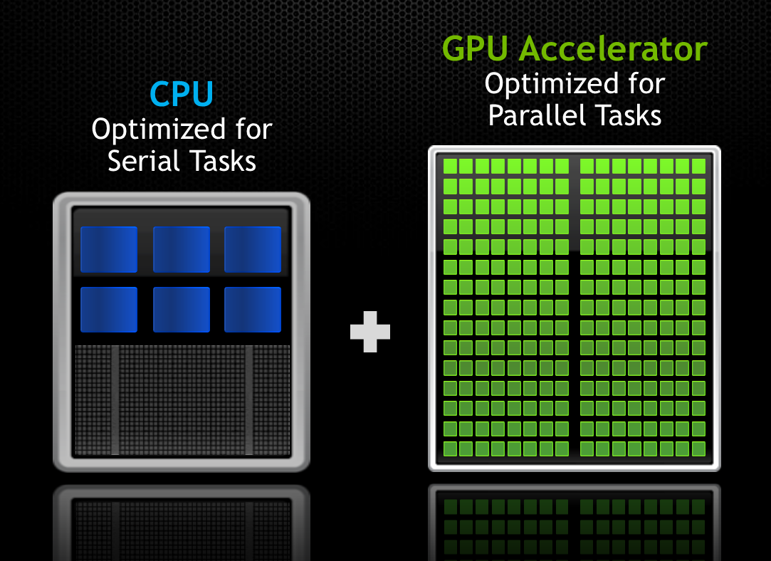
Topology of the GPU
Lots and lots of small processors at current otherwise known as SMs, Streaming multiprocessor
Notes:
CPU
lots of cache
Few complex cores
GPU
smaller caches
simpler SMs or “streaming multiprocessor”
GPU clock speed is slower than the CPU
Titain Z clock speed
700MHz
Boost ~ 900MHz
CPUs 3 to 4xs that speed

Slide 5
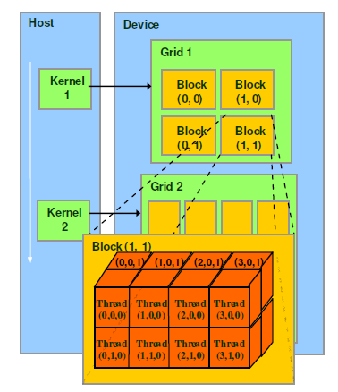
Organisation of threads
Notes:
CUDA model
Kernel
Grid
Block
Thread
Why Blocks?
Hardware constraints
Warps
Memory fence for block
No memory fence for grid
Blocks not run same time

Slide 6
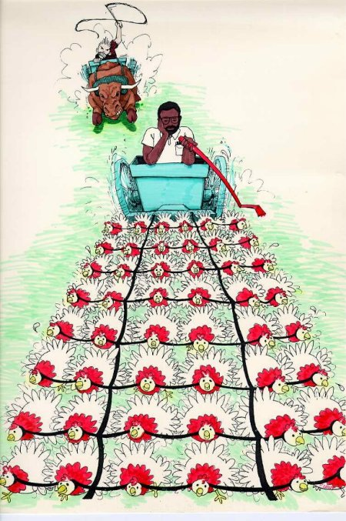
Introduction to parallel programming
As apposed to serial programming
Notes:
The key point to using the GPU is the massively parallel architecture

Slide 7
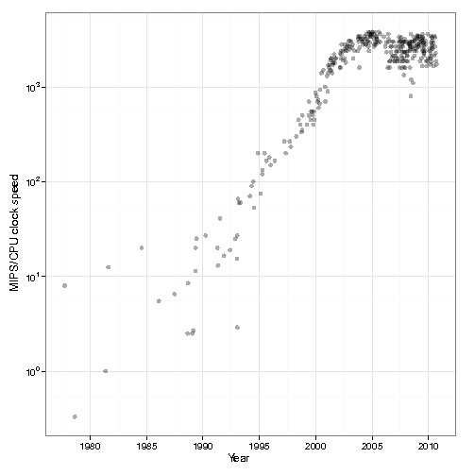
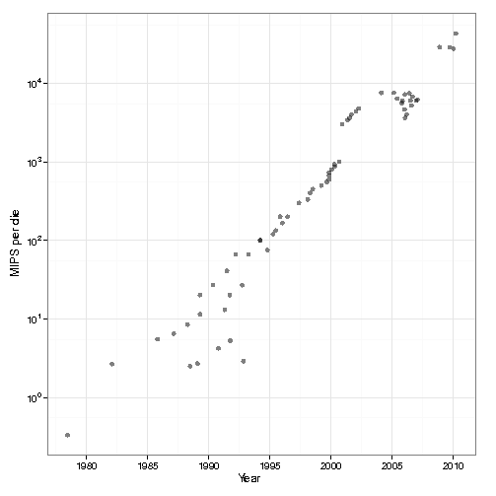
CPU evolution to parallel architecture
Notes:
Applications more complex
CPU frequency wall
million instructions per second increase
More cores
5th gen i7 CPUs clock speed 3-4GHz
AMDs latest clock speed up to 5GHz.
hard to find a CPU one core
low power domain

Slide 8
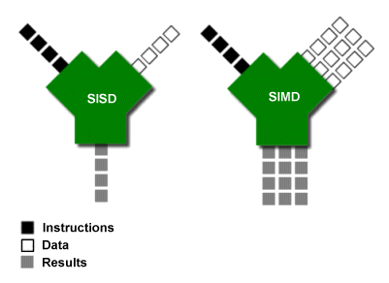
Single Instruction Multiple Data (SIMD)
Notes:
SISD
SIMD
MIMD
lots of data through the same instructions
vector operations on the CPU
Intel Xeon Phi (up to 61 cores) MIMD machine
multiple programs on different cores
multiple data same time

Slide 9
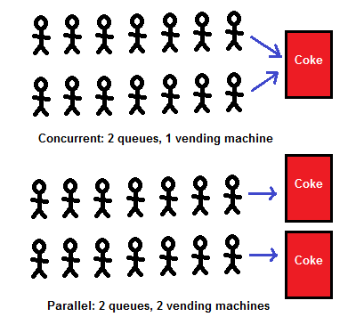
Concurrency vs Parallelism
CPU for task parallelism
GPU for data parallelism
Notes:
Basketball > task parallelism
Swimming > data parallelism
Hyper-threading > good example of concurrency
Concurrency will not improve performance of an application!
Multi-core systems > good example of parallel architecture
CPU
large caches
context switching
GPU
large number of processors
Computing data in parallel

Slide 10
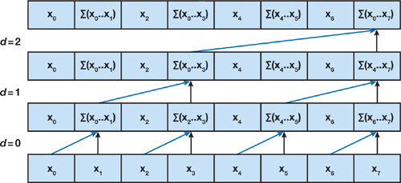
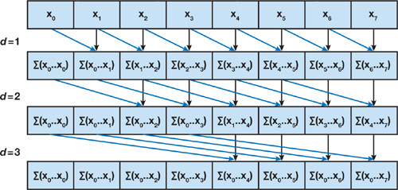
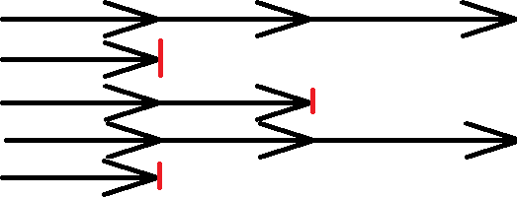
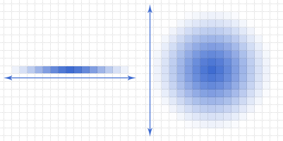
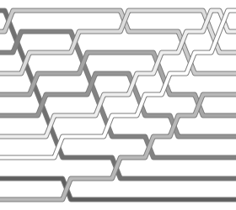
Basic GPU design patterns
Map
Reduce, Scan
Filter
Scatter, Gather
Sort, Search
Notes:
Map > Transform X with transform T to Y.
Reduction> reduce
one output
Scan > same
n input, n output
An example of using Scan might be radix or quick sort.
Filter > conditions and predicates
Scatter & Gather>
blurring an image
Scatter > each pixel to affect its neighbours
Gather > observe neighbours to affect itself
Sort and search > simple
searching sequential
searches in parallel

Slide 11
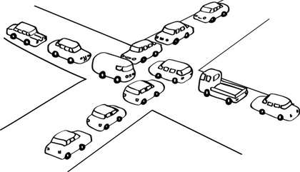
Lock free parallel programming model
Roads, traffic lights and clover leafs…

Slide 12
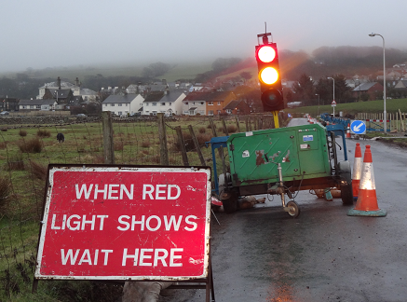
Problems with locking
Deadlock & Livelock
Priority inversion
Convoying
Asynchronous signal safety
Kill tolerance
Races
Simplicity vs scalability
Notes:
Deadlock > processes intertwined to wait for each other that cannot proceed
Livelock > same but movement
Priority inversion > low priority processes holding locks required by a higher priority process
Convoying > locks in a similar order meaning one slow process can get in first and slow the later processes
Asynchronous signal safety > thread calls printf, and another thread signals another printf output is garbled
You can’t just put a lock on this cause an immediate deadlock
the handler which already received the signal, waiting for itself to release lock
Kill tolerance - threads holding locks are killed/crash unpredictable behaviours
Races - forgetting to lock or locking the wrong thing
Simplicity vs scalability > coarseness of lock

Slide 13
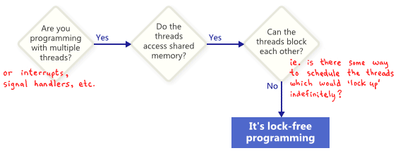
Lock free approaches
Rather than locks, use memory fences
Can produce better performance and scalability
Difficult to get right
while (X == 0){
X = 1 - X;
}
Notes:
Lock free (CPU) programming is hard
performance is critical
Use memory fences
Or assert sequential consistency of memory
Doesn’t cure contention
lots of threads can be competing for a lock free data structure
Starvation of thread still possible

Slide 14
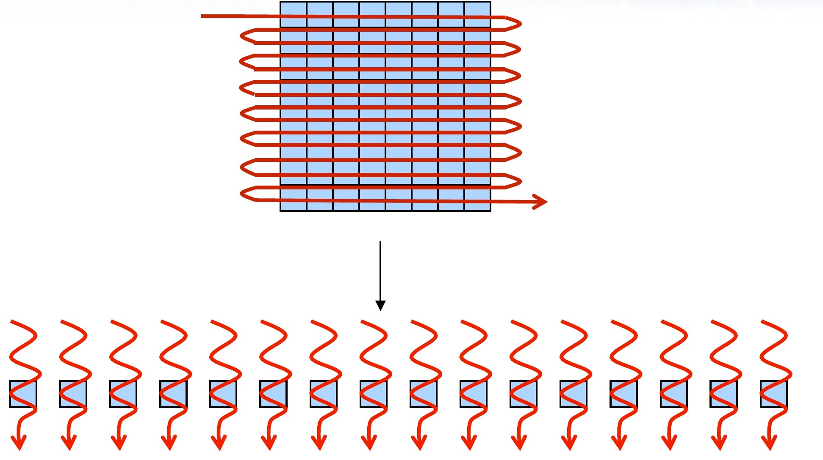
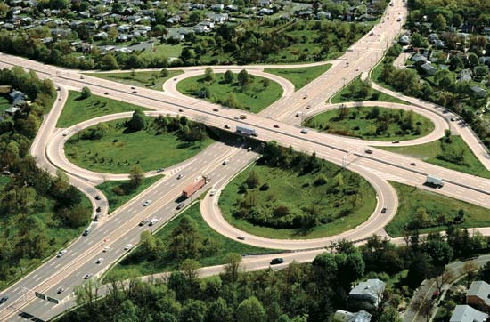
Methodology comes natively using the GPU!
The GPU uses streams, pipelining as for textures, with this model gives us a nice lock free sandbox
Notes:
Lock free is not wait free
Offload our data to the GPU
wait for it to do some stuff
then copy the data back
Wait free
staging areas
monitors read memory buffer reserved for the display
Pointer to a large data structure
modify this with one atomic operation
entire data structure is visible
Wait free is not very common to use with the GPU
discrete transform to compute
GPU memory fences
ensure that data is correct when using it
“syncthreads”
all instructions preceding have been completed

Slide 15
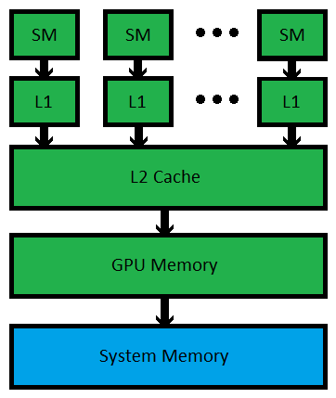
GPU Memory model
Can’t we just abstract this away?
Notes:
GPU memory is explicit!

Slide 16
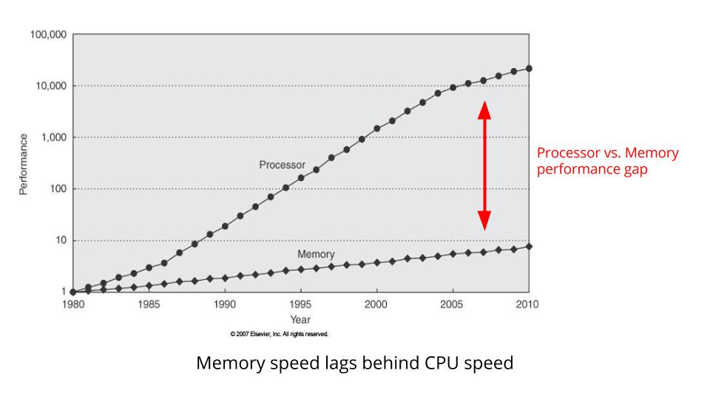
Memory performance gap
Notes:
Memory speed is lagging behind processor speeds
Applications with large data sets are slowed down by cache misses

Slide 17
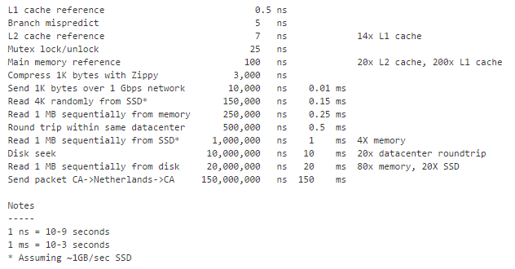
Keep the focus on the memory
Notes:
Credit to Jeff Dean from google
“Latency numbers every programmer should know”
L1
L2
Disk seek
GPU similar
size of cache with the fastest access
largest memory with the slowest access
important to get a high information density in all memory transfers
bottleneck of the program
Use Cache to get peak performance in parallel programs
Histograms
Atomics in shared memory
Few atomics to global

Slide 18
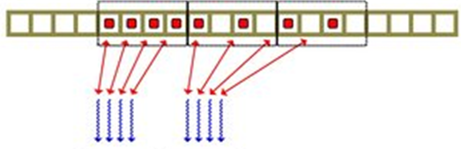
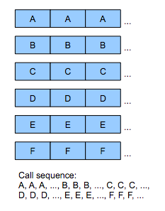
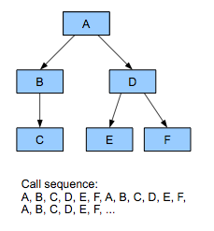
Keep the focus on the data
Data oriented design as an alternative to Object oriented design
Easier to write parallel code for
Better cache utilization
Improved modularity
Easier testing
Coalesced
Strided
Notes:
Big problem cache missing
Layout data better
Structure of arrays >> array of Structures
Coalesced > Strided
Ball
-Position
-Size
Offloading data easier
transfer data to transform
group of objects with hidden data
Easier for measuring performance
crucial part of optimizing algorithms
why GPU is used

Slide 19

Practical example
A sharp image from lots of less sharp images
Notes:
Justin’s talk on 3d Imaging
Focus variation
Lots of 2d image
3d depth

Slide 20
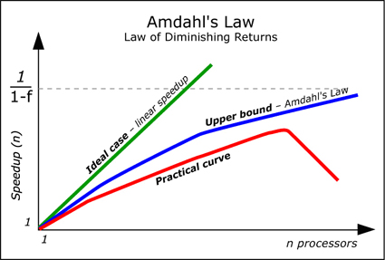
Tips for converting a problem to a parallel solution
Decompose the problem
Start with a simple single threaded approach
Understand where there is data parallelism (most obvious being large arrays)
Start with a naive parallel approach to exploit this
Benchmark
Optimize
Benchmark
Optimize
ect...
Notes:
Start simple
Iterate
Benchmark
Of course getting to faster solutions quicker will come with experience
Sometimes can't get back the overhead
Of moving the memory to GPU and back
Stick with CPU and parallelize
best optimizations - memory contention
From design, memory layout
Improvements on the 1st, 2nd, 3rd will be enough
to program on a GPU
go further if the constraints are really tight!
Quote from Donald Knuth “Premature optimization is the root of all evil”

Slide 21

Focus variation example
CPU Version
One thread, iterate over all pixels. Lucky if compiler vector-ise some scalar operations, otherwise need to explicitly declare this
For each image in image set:
For each pixel in image:
Calculate focus for this (X)
For each pixel in image:
Calculate focus for this (Y)
Sum square value from x and y sweep
For each pixel in image:
Compare pixel values from different images
Select pixel with the best focus
Focus Variation Algorithm
Input images at different focus
For each position the focus over each plane is calculated
Focus calculated at every pixel with convolution of [-1,2,-1] across both X and Y, sum squared
Plane with the best focus is used to get a sharp image. the corresponding depth gives the depth at this position
Notes:
Similar to High Dynamic Ranging
Using edge definition rather than contrast
As per Wikipedia
Take series of images in different focuses
Each position the focus over each plane is calculated The plane with the best focus, and the corresponding depth at that position
CPU implementation
Two pass X & Y
A final pass to sum and square X and Y values
final set of focus values
max/min function across images
merge into a final image
Why two pass?
reuse data from cache
For Each loop?!
Put on GPU

Slide 22
Focus variation example
GPU Version
One thread for each pixel using global memory. Each thread can access any part of the image at whim
Launch number of images * number of pixels threads
Calculate focus at this pixel value and write result to global memory
Sum square value from x and y sweep
Launch number of pixel threads
Compare pixel values from different images
Select pixel with the best focus
Focus Variation Algorithm
Input images at different focus
For each position the focus over each plane is calculated
Focus calculated at every pixel with convolution of [-1,2,-1] across both X and Y, sum squared
Plane with the best focus is used to get a sharp image. the corresponding depth gives the depth at this position
Notes:
First naïve implementation
Replace for each launching threads
Exploit some of the parallelism in the problem
Step is hard?
Too entangled foreach > re-evaluate original problem
Each pixel different thread
Quickly saturate the GPU
Density of work per memory transfer is low because of only doing one pixel at a time
Global memory is slow
First stab may be slower than CPU
High Memory bandwidth

Slide 23
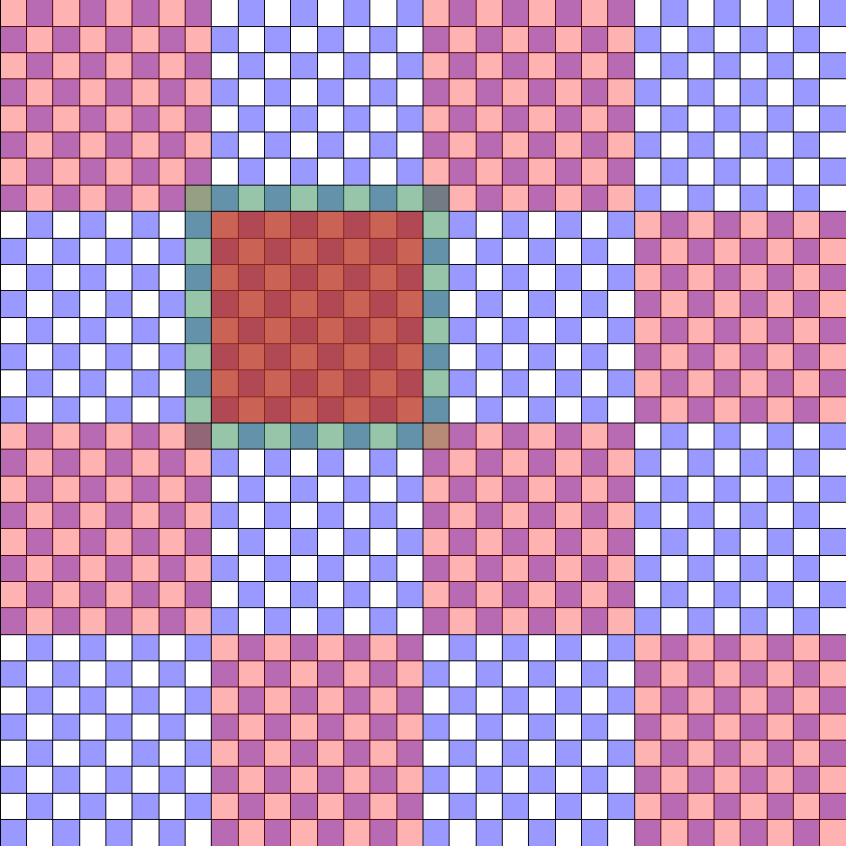
Focus variation example
First Sweep of optimization
Tile the image, move parts of the image into shared memory. Threads can access only part of the image relevant to them
Launch number of images * number of pixels threads
Load in pixels in the tile to shared memory
Calculate focus at this pixel value and write result to global memory
Sum square value from x and y sweep
Launch number of pixel threads
Compare pixel values from different images
Select pixel with the best focus
Focus Variation Algorithm
Input images at different focus
For each position the focus over each plane is calculated
Focus calculated at every pixel with convolution of [-1,2,-1] across both X and Y, sum squared
Plane with the best focus is used to get a sharp image. the corresponding depth gives the depth at this position
Notes:
Global memory is slow
Move to faster memory
Shared memory is shared by a “block” of threads
Not visible to all threads
smaller than global memory
One large memory transfer at start and end
Reduced global memory bandwidth
Still low work per information

Slide 24
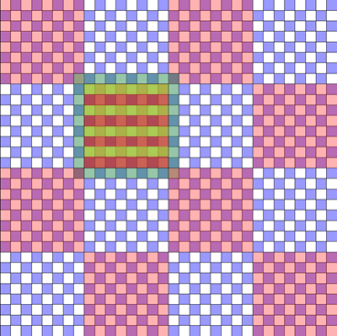
Focus variation example
Second Sweep of optimization
Increase work per thread. Load nearby pixels into local memory, threads access explicitly only what they need from local memory
Launch number of images * number of pixels / serialization factor threads
Load in pixels in the tile to shared memory, load useful information into local memory
Calculate focus at this pixel value and nearby pixels and write result to global memory
Sum square value from x and y sweep
Launch number of pixel threads
Compare pixel values from different images
Select pixel with the best focus
Focus Variation Algorithm
Input images at different focus
For each position the focus over each plane is calculated
Focus calculated at every pixel with convolution of [-1,2,-1] across both X and Y, sum squared
Plane with the best focus is used to get a sharp image. the corresponding depth gives the depth at this position
Notes:
Increase serialization
less threads
balance compute and memory transfers
Local memory faster again
Basic memory handling done!
Fast solution
satisfactory to the requirements of the problem
Best focus is memory contention
smaller speedups
-Consider warp size
-Reduce branching
-Avoid memory bank conflict
-Unrolling for loop, stop useless instructions

Slide 25
Applications of GPGPU
What can’t be done on the GPU?!

Slide 26

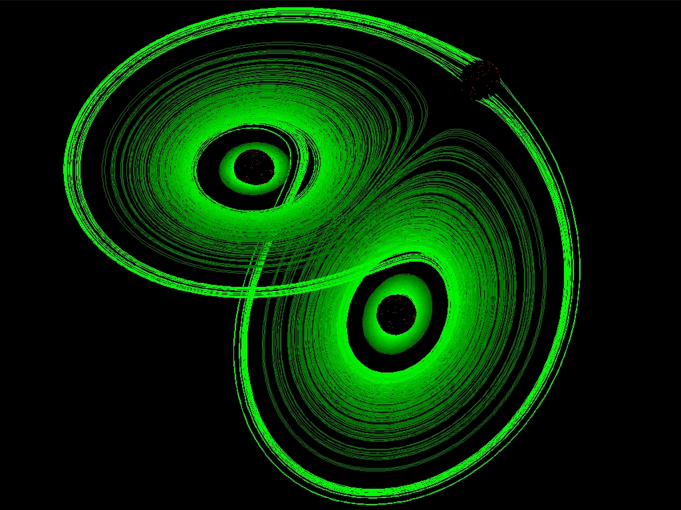
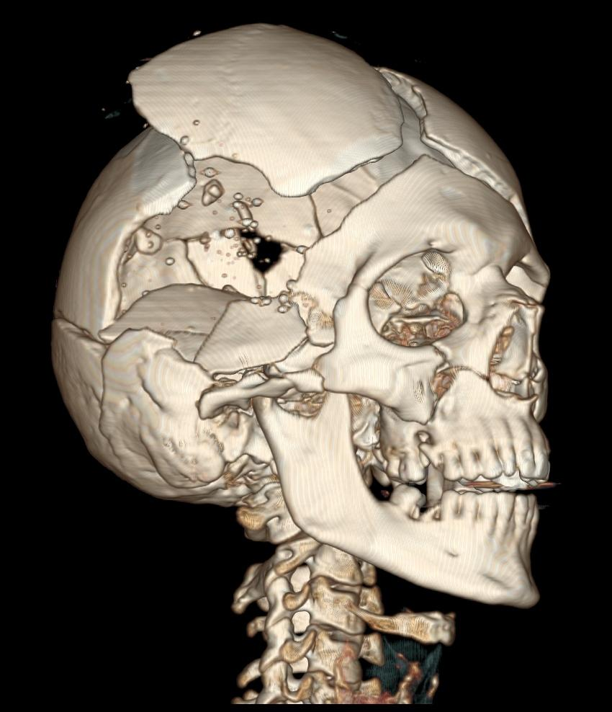
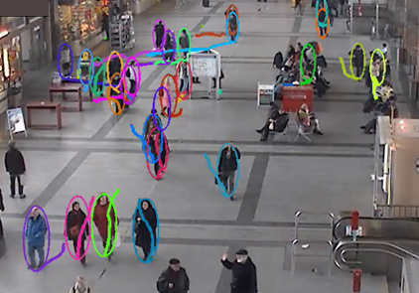
Where can I leverage the power of GPU?
Bioinformatics
Molecular biology
Physics based simulations
Statistical models
CT reconstruction
FFT
Machine learning
Image and audio processing
Simulations
Cryptography
And increasingly many more!
Notes:
Specialist libraries are available
And free
Wikipedia found 9 different CUDA libraries for bioinformatics
Sequencing mapping -> motif discovery
Expected speed-ups from 6x to 400xs over a CPU only solution

Slide 27
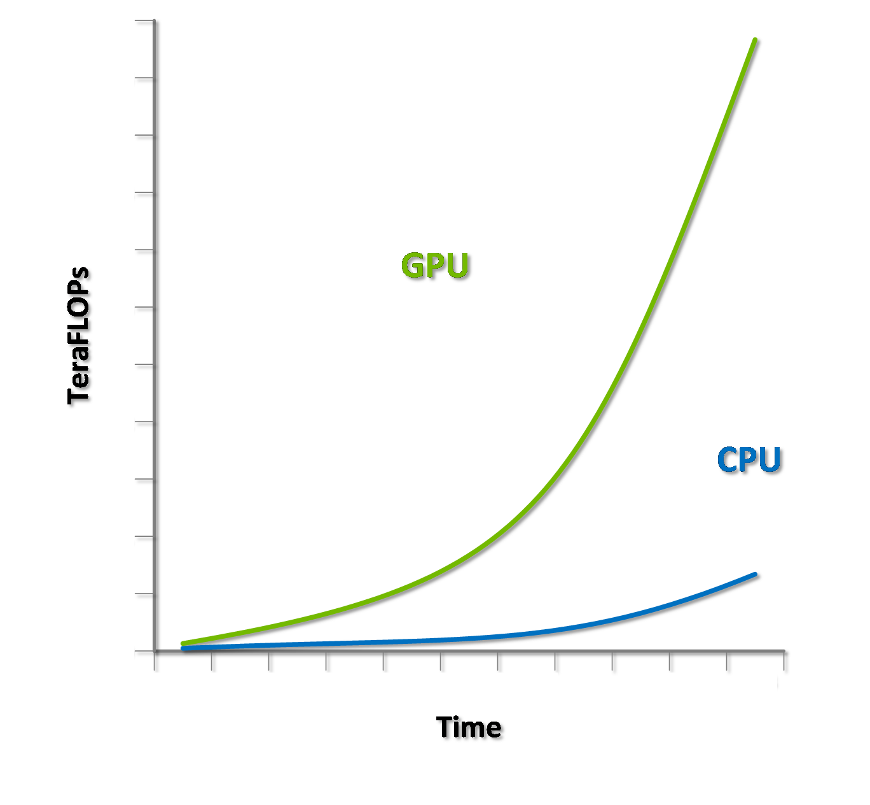
Conclusions
The GPU is super cool!

Slide 28

Getting a truley parallel solution isn't always the best!
Take advantage of the extra work capacity, trade off step complexity for work complexity. Not having a high percentage occupation of the GPU often indicates there are optimizations to be made
Increase the serialization of a program to better hide memory latency
GPUs are now better in power, performance and cost over CPUs, so if the problem has parallel components, it's usually the right step
Notes:
Fill up the GPU
OK to have lots of SMs to do the same thing
if fewer memory transfers
Serialization
Increase work per thread
Thread compute 4, 16 or however many pixels will increase the work per thread
Get memory from a faster level of memory
Less time waiting for memory transfers
Fill up the memory bandwidth
optimize memory transfers

Slide 29







Options for GPGPU From GPU Kernels to compiler directives
OpenCL – __kernel void mykernel(){}
CUDA – __global__ void mykernel(){}
OpenMP - #pragma omp parallel for
OpenACC - #pragma acc parallel
OpenHMPP - #pragma hmpp simple1 codelet, args[outv].io=inout, target=CUDA
C++ AMP - parallel_for_each( );
Cilk Plus - cilk_spawn recursion(...);
Also many more that I can't fit onto this slide…
Notes:
OpenCL and CUDA
for programming the GPU
most flexibility
I have learned CUDA
OpenCL port not hard
OpenCL >
Open computing language, Industry standard for heterogeneous computing
target CPUs, GPUs, DSPs, FPGAs + more
very good code reuse
CUDA >
Most popular for GPGPU
lots of libraries available
limited to only NVidia hardware

Slide 30
CUDA | OpenCL
Thread | Work-item
Thread block | Work-group
Global memory | Global memory
Constant memory | Constant memory
Shared memory | Local memory
Local memory | Private memory
__global__ function (callable from host, not callable from device) | __kernel function (callable fromdevice, includingCPU device)
__device__ function (not callable from host) | No annotation necessary
__constant__ variable declaration | __constant variable declaration
__device__ variable declaration | __global variable declaration
__shared__ variable declaration | __local variable declaration
gridDim | get_num_groups()
blockDim | get_local_size()
blockIdx | get_group_id()
threadIdx | get_local_id
No direct equivalent. Combine blockDim, blockIdx, and threadIdx to calculate a global index. | get_global_id()
No direct equivalent. Combine gridDim and blockDim to calculate the global size. | get_global_size()
Notes:
Similar CUDA and OpenCL
Boilerplate different
Same design pattern

Slide 31
Useful resources
Courses
https://www.udacity.com/course/intro-to-parallel-programming--cs344 (I highly recommend this course)
Lots of universities host their course slides online, often very handy http://courses.cms.caltech.edu/cs101gpu/ https://code.google.com/p/stanford-cs193g-sp2010/ http://imat.hwu.crhc.illinois.edu/ECE408-2013/ECE408%202013%20Materials/Forms/AllItems.aspx
Materials
http://malideveloper.arm.com/develop-for-mali/tutorials-developer-guides/developer-guides/mali-t600-series-gpu-opencl-developer-guide/
http://handsonopencl.github.io/
http://developer.amd.com/tools-and-sdks/opencl-zone/opencl-resources/programming-in-opencl/
https://developer.nvidia.com/gpugems/GPUGems3/gpugems3_pref01.html (Probably the hands down best reference guide for CUDA programming)
https://docs.google.com/presentation/d/17Bzle0w6jz-1ndabrvC5MXUIQ5jme0M8xBF71oz-0Js/edit#slide=id.i0
https://www.youtube.com/channel/UCMlGfpWw-RUdWX_JbLCukXg (cppcon14)
https:// www.youtube.com/watch?v=rX0ItVEVjHc
Notes:
Most GPU code written for you
Useful for fundamental algorithms : scan, map and reduce
It’s fast and optimised
Udacity course, taught by John Owen and David Luebke from Nvidia
University courses freely avaliable
ARM on programming onboard GPU
GPUGems best reference for CUDA
CppCon
Focus on parallel designs
Mike Action > data oriented design
Jeff Preshing > lock free programming on multicore systems
Pablo Halpern > parallelism with a focus on Cilk
Ade miller > writing data parallel algorithms on GPUs

Slide 32
Questions?

